Slide 1

Module 3
System Users

Slide 2
Objectives
Learn about the importance of access levels and roles in cybersecurity
Explore the differences between the different access levels in Enigma Glass
Learn about the “user” role specifically and what that looks like in Enigma Glass

Slide 3
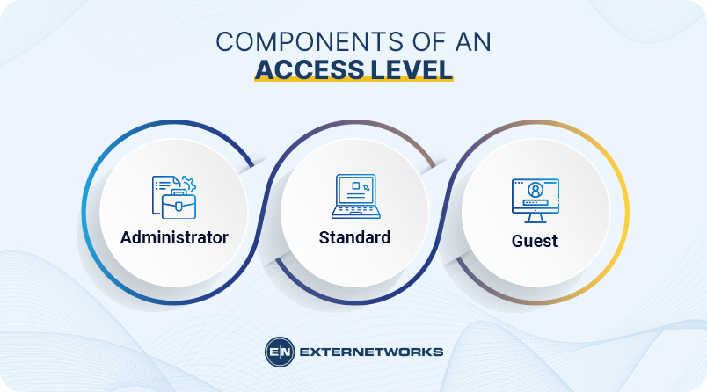
Access Levels
Access levels are a critical defense against insider threats and accidents in the workplace.
They give or restrict certain permissions and actions based on what access level you were given. The higher the access level, the more permissions you will have.
Common access levels include guest, user, and administrator.

Slide 4
Access Levels
The importance of access levels can vary dramatically depending on the size of a company’s security team.
A small company may simply only have on security analyst whose role is administrator.
Larger companies may have several administrators and a large amount of regular users. They may also reserve guest or lower access accounts for trainees.

Slide 5
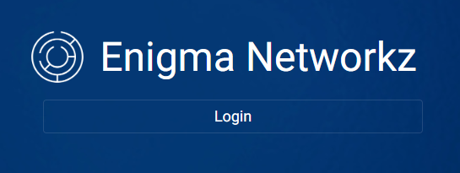
Access Levels in Enigma Glass
When learning how to use Enigma Glass, individuals will be given accounts with the role of user.
The user role is generally considered the standard access level. It gives users permissions to access all of the information they need, while restricting them from the information they do not need.

Slide 6
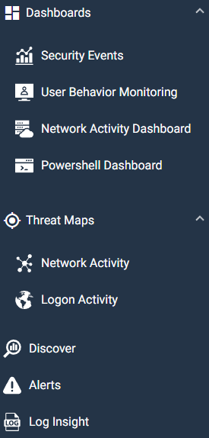
Users in Enigma Glass
Users in Enigma Glass have access to 6 different modules by default.
These modules include dashboards, threat maps, discover, alerts,
and log insights.
The user role also has access to four different types of dashboards
and two different types of threat maps.

